Slide 1
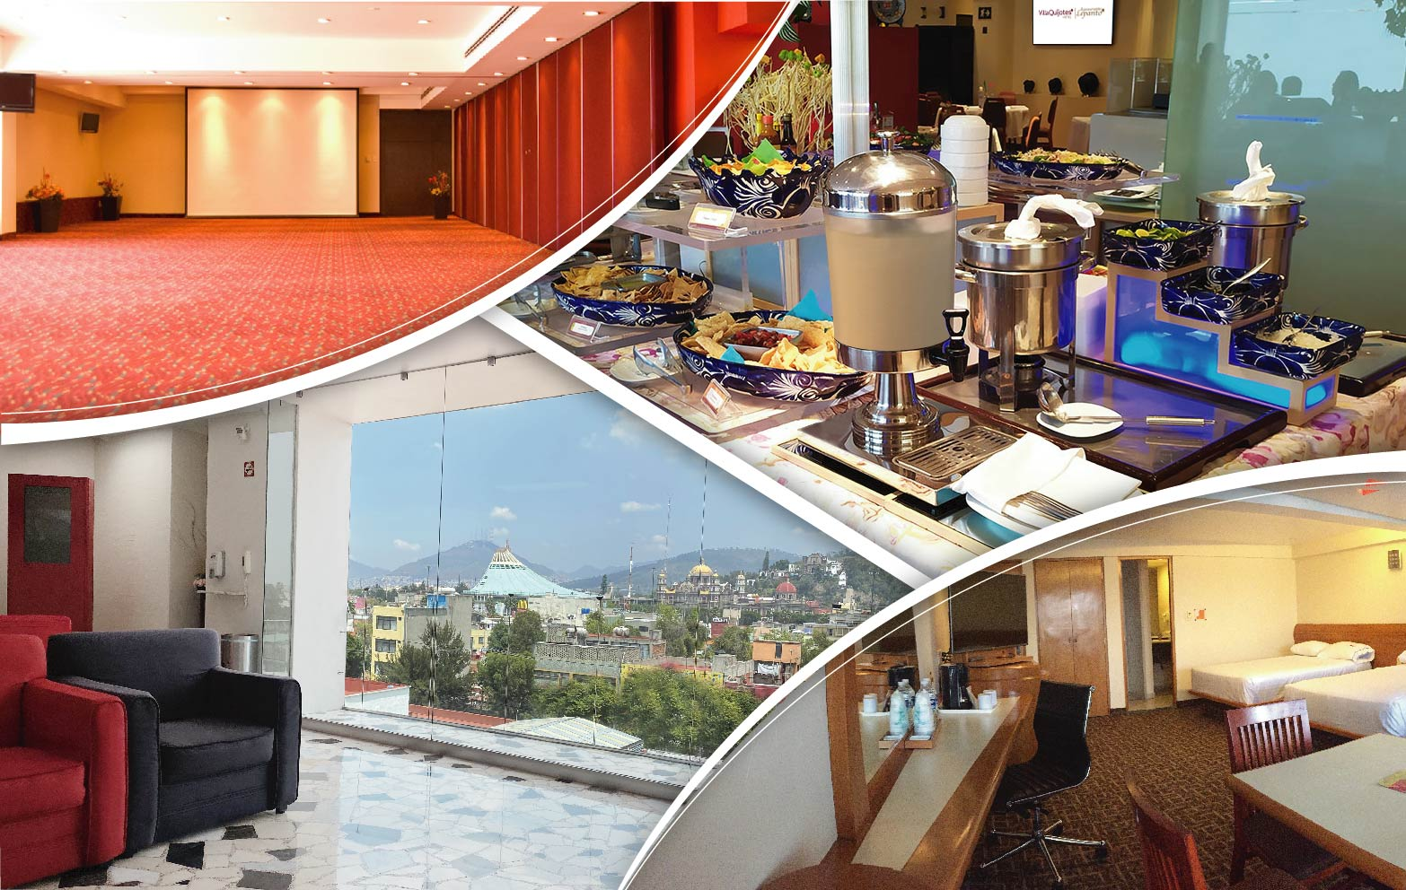


Slide 2
ASSOCIATES
Ms. Shrawani Mangesh Kadam
Ms. Fathima Afrin
Ms. Sayali Ganesh Thakur
Ms. Tejaswi Anil Ovhal
Mr. Babu. M
Mr. Vaibhav Kale

Slide 3
CONTENTS
Overview on Data Analytics in Hospitality
KPI’s
Excel Dashboard

Slide 4
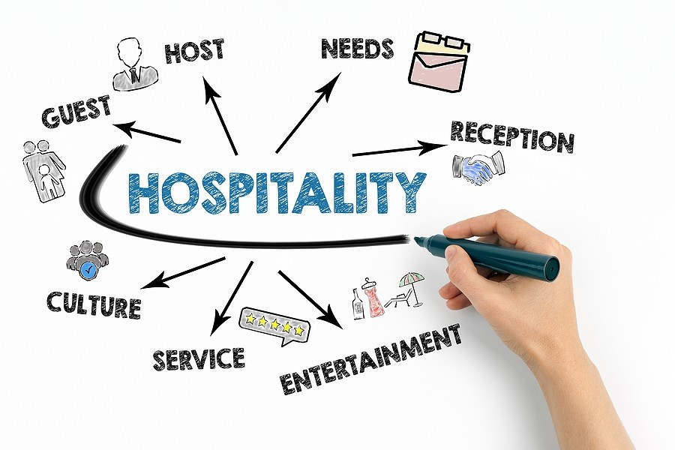
Overview on Data Analytics in Hospitality
Data analytics in hospitality refer’s to collecting and analyzing data points from various sources to make more informed business decisions. Data can point you to the best ways to optimize operations, enhance customer experiences and improve your hotel's performance. With tools like customer relationship management systems, predictive analytics, and business intelligence platforms, data analytics helps hotels, resorts, and restaurants stay competitive, deliver personalized experiences, and maximize revenue.

Slide 5
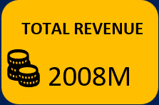
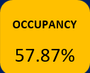
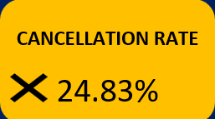
Total Revenue
This figure represents the total revenue generated by the hospitality sector, reflecting overall business performance and market demand.
Occupancy Rate
The occupancy rate indicates the percentage of available rooms that were occupied over a specific period, crucial for assessing operational efficiency
Cancellation Rate
The cancellation rate of 24.83% indicates a significant number o+ bookings that were canceled, which can impact revenue and planning
.

Slide 6


Total Bookings
The total number of bookings made, which is critical for understanding customer demand and planning for capacity.
Utilization Capacity
Indicates the total capacity utilized, providing insights into how effectively the available resources are being used.

Slide 7
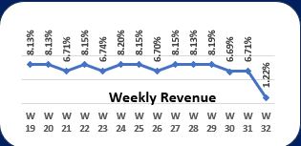
Revenue Analysis
Possible Reasons for the Drop Seasonality: Certain weeks might have lower revenue due to holidays, vacations, or seasonal slowdowns. Operational Issues: Factors like stock shortages, system downtime, or staff shortages could impact revenue. Market Competition: A new competitor or promotions by rivals might have drawn customers away.
Improve Revenue 1. Analyze the Root Cause 2. Optimize Marketing Strategies 3. Enhance Service Offerings 4. Improve Operational Efficiency 5. Monitor Competitors

Slide 8
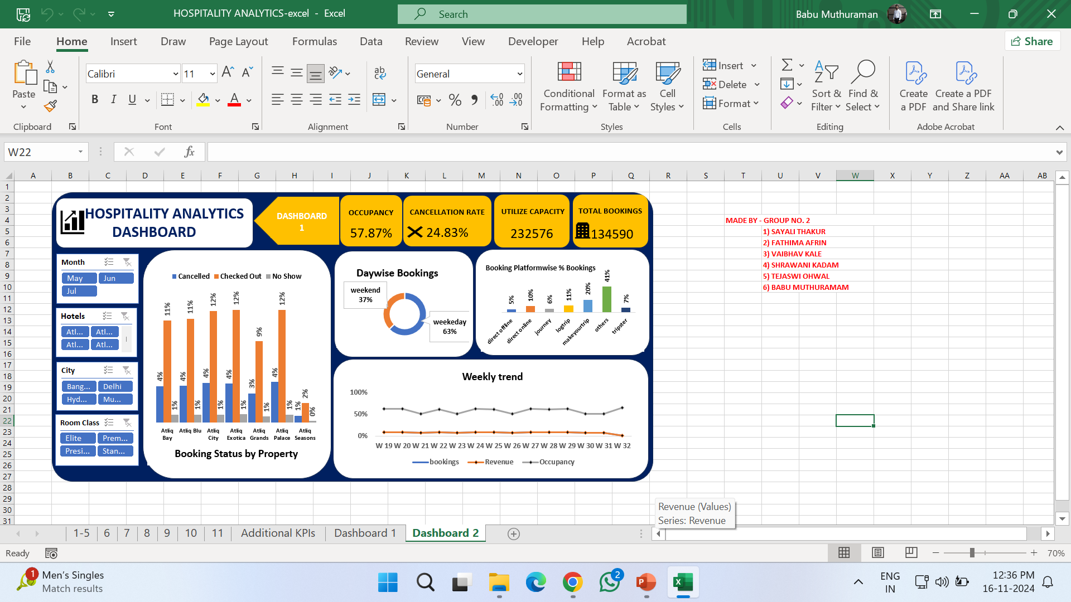
Occupancy and Bookings
Occupancy is moderate but has potential for improvement.
Cancellation rate is high, indicating a need for action to reduce drop-offs.
Utilized capacity suggests consistent demand, but there is room to grow.
Total bookings are healthy but could benefit from targeted campaigns Key Challenges High cancellation rate (24.83%) leading to revenue loss. Underutilized capacity (occupancy below 60%). Need to increase customer retention and attract new bookings. Improvement Strategies Reduce Cancellation Rate: Flexible cancellation policies. Automated reminders and follow-ups. Offer incentives for retention (e.g., future discounts).
Increase Occupancy: Launch dynamic pricing and promotional campaigns. Partner with online booking platforms to reach a wider audience.

Slide 9

Trend Analysis
Improve Bookings and Revenue:
Promote special offers or discounts in weeks with traditionally
low performance.
Target digital marketing efforts to attract new customers.
Occupancy Optimization:
Adjust pricing dynamically to align with demand.
Monitor underutilized weeks and focus on customer
engagement campaigns.

Slide 10
Actionable Insights and Recommendations
Optimize Revenue:
Identify high-revenue channels and suggest increasing investment.
Reduce Cancellations:
Propose policies to mitigate cancellations (e.g., stricter cancellation fees).
Improve Occupancy:
Suggest targeted marketing for low-occupancy periods or discounts to improve capacity utilization.

Slide 11
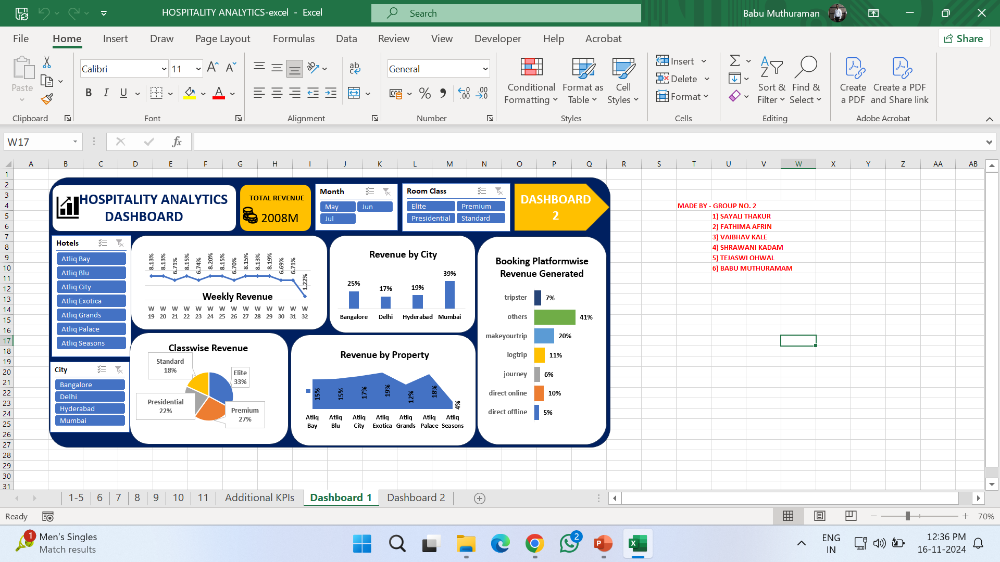
Hospitality Analytics Dashboards

Slide 12
Thank You!

